Slide 1
Mancala
Presented by: Chase Marsh, Michael Kasper, Aaron Stahley, and Payal Pandit

Slide 2
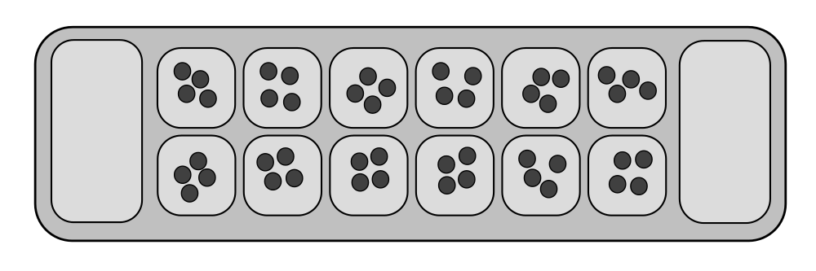
Requirements & Features
Two players
A board with a series of holes arranged in 2 rows (6 pits in each row)
Two scores (pit for scoring, one at each end of the board)
Playing pieces (stones in our case)
With a two-rank board, players usually are considered to control their respective sides of the board, although moves often are made into the opponent's side.

Slide 3
Rules of the Game
Four stones are placed in each of the 12 pits (excluding the scoring pits).
One player starts the game by picking up all of the stones in any one of his/her own pits. Moving counter-clockwise, the player places one in each pit starting with the next pit until the stones run out.
If you run into your own Mancala (scoring pit), place one stone in it. If there are more stones to go past your own Mancala, continue placing them into the opponent's pits. However, skip your opponent's Mancala.
If the last stone you drop is your own Mancala, you get to take another turn.
If the last stone you drop is in an empty pit on your side and your opponent's opposite pit has stones, you get to move that stone and all of your opponent’s stones that are in the opposite pit into your scoring pit.
The game ends when all six pits on one side of the Mancala board are empty.
The player who still has stones on his side of the board when the game ends captures all of those pieces and places them in their Mancala.
The player who has the MOST stones in their Mancala wins.

Slide 4
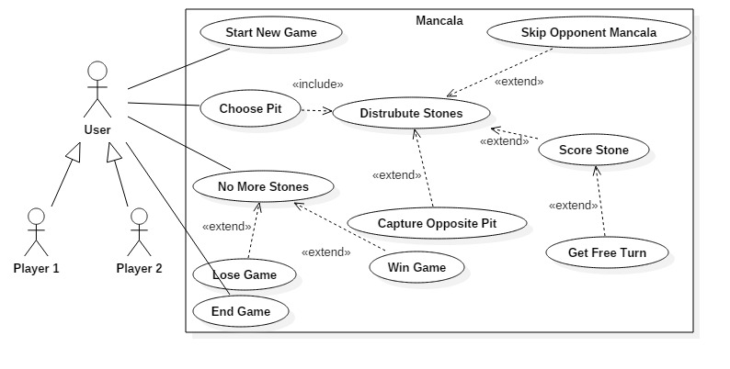
Mancala Use Case (UML)

Slide 5
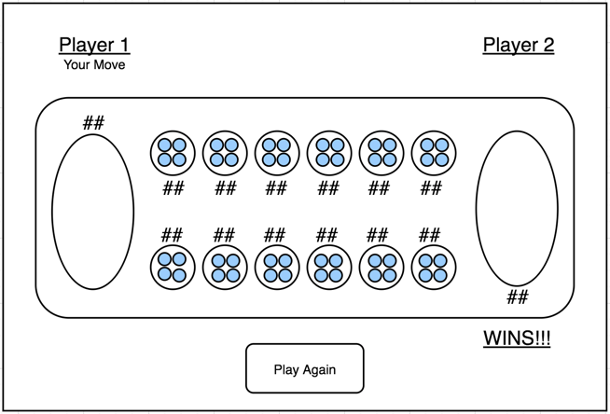
UI Mockup

Slide 6
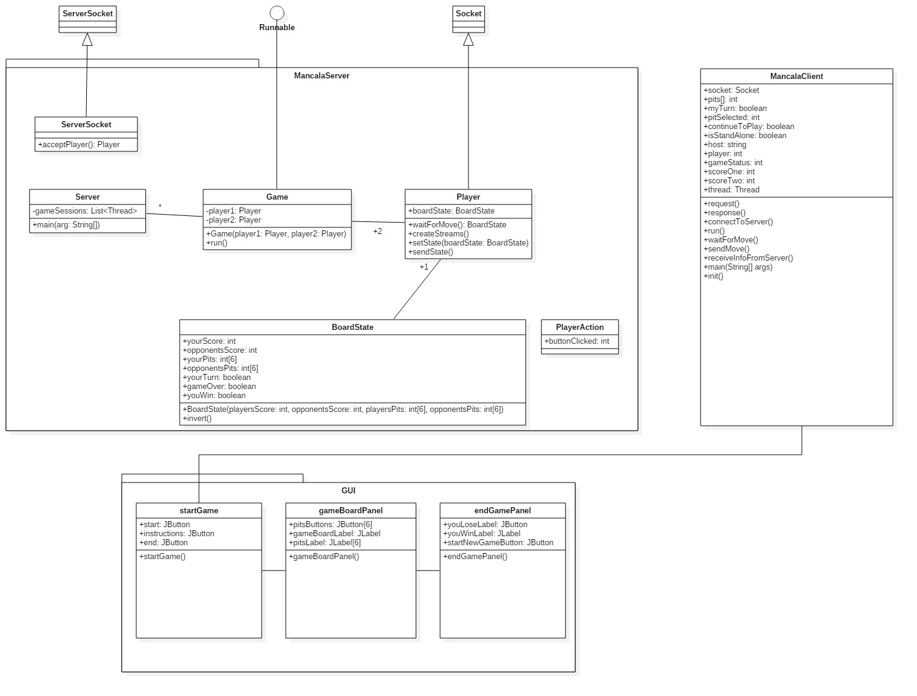
Mancala Class Diagram (UML)

Slide 7
Presentation

Slide 8
Project Status
Planning: Done
Design: Done
Coding/Compiling: Done
Testing: In Progress
Final Release: Not Complete

Slide 9
Team Member Roles
Aaron Stahley: GUI/Client, Tester
Michael Kasper: Server/Game Engine, Tester
Payal Pandit: Server/Game Engine, Tester
Chase Marsh: Client, Tester

Slide 10
Additional features if we have time
Animation
Stones animate as the move from one pit to another
Different board layouts
User can select different looking boards

Slide 11
GitHub
https://github.com/AaronStahley/SER215

Slide 12
Any Questions?

